Slide 1
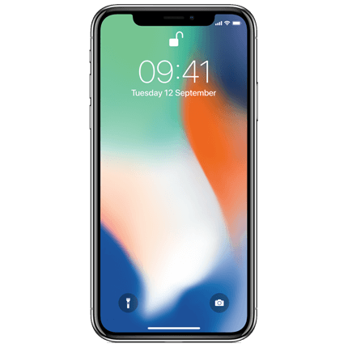
Apple iPhone X Face ID Hack
By Matthew Austin & Brett Lange

Slide 2
iPhone X Face ID Security
A week after the release of the iPhone X a team of hackers were successfully hacked Face ID recognition technology with a mask that cost less that $150.
Apple claimed that its Face ID was “ultra secure”.
Apple used masks to train the iPhone X against these types of Face ID hacks.

Slide 3
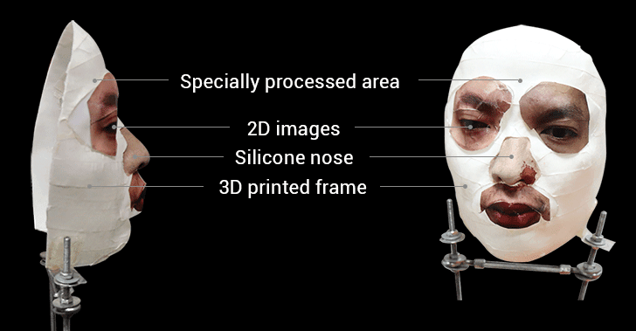
Face ID Hackers
Researchers from Vietnamese cyber security firm Bkav were able to unlock iPhone X using a mask.
The mask was created using a 3D printed mask, makeup, and 2D images, and silicone (for the nose).

Slide 4
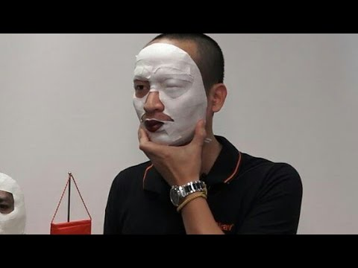
Video Proof

Slide 5
Bkav Statements
Many people around the world (including them) have tried different kinds of masks and failed.
Bkav stated they were only successful because they fully understand how the AI of Face ID works and how to bypass it.
Bkav claims that even when you cover half of you face the iPhone will still unlock meaning that the Face ID’s security isn’t strict.

Slide 6
Prevention
Creating a mask to unlock someones phone is a time consuming process.
Disable fingerprint and/or Face ID to unlock your phone.
Apple needs to make Face ID stricter.
Keep iPhone in a safe/secure place.

Slide 7
References
https://thehackernews.com/2017/11/iphone-face-id-unlock-hack.html
https://www.wired.com/story/hackers-say-broke-face-id-security/
http://www.bbc.com/news/av/technology-41992610/face-id-iphone-x-hack-demoed-live-with-mask-by-bkav

